Slide 1



Slide 2


Slide 3
Intro to Programing with
Text Adventure Games
EmilyPrograms
That Conference 2015

Slide 4
Text Adventure is great for kids!
Pedagogy [ped-uh-goh-jee] the techniques and methods used to teach children
Andragogy [an-druh-goh-jee] the techniques and methods used to teach adults
Kids learn through repetition, adults learn through relating to past experience
There are (4 other aspects too)

Slide 5
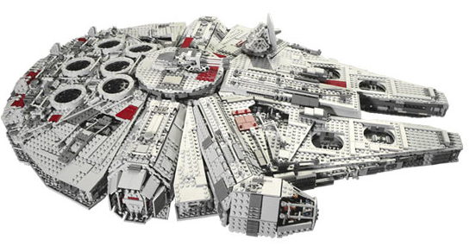
Only expert Lego programmer could build this without instructions
(Equivalent of Software Architect)
Courtesy of LEGO.com

Slide 6
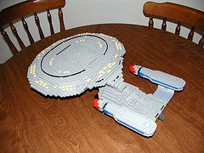
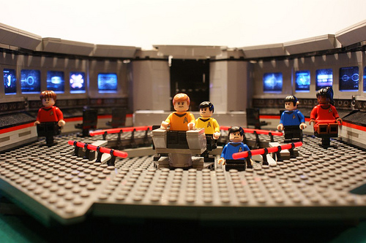
How do you Learn Enterprise Architecture?
http://davereed.tumblr.com/post/189443481/lego-star-trek
http://web.me.com/happywaffle/Legoprise/Home.html

Slide 7
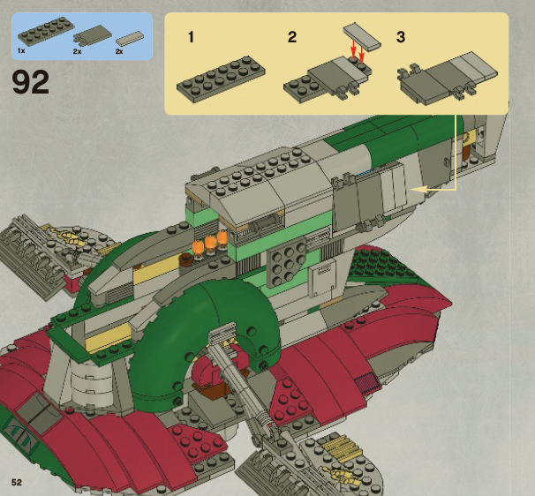
Step by Step
Courtesy of LEGO.com

Slide 8
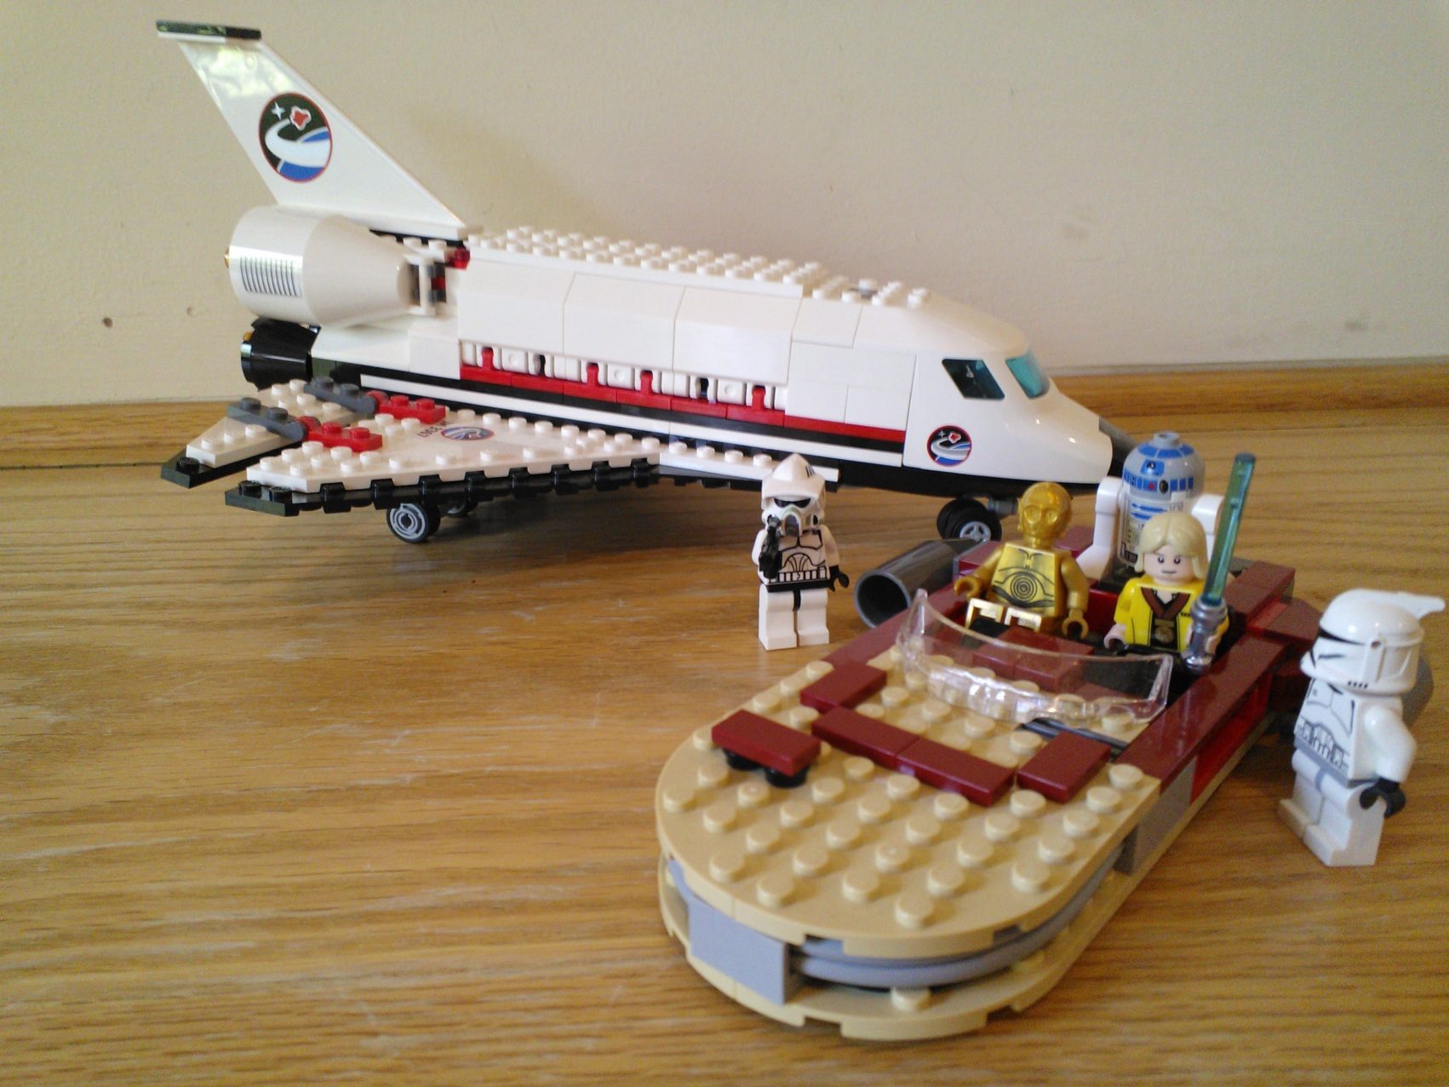
How Kids Learn Legos

Slide 9
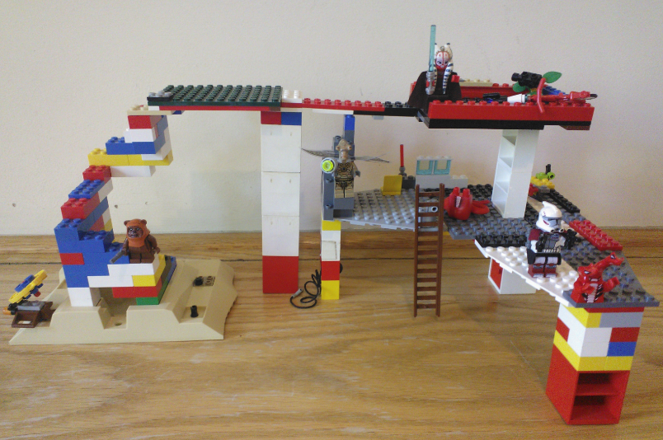
Once You Get the Fundamentals

Slide 10
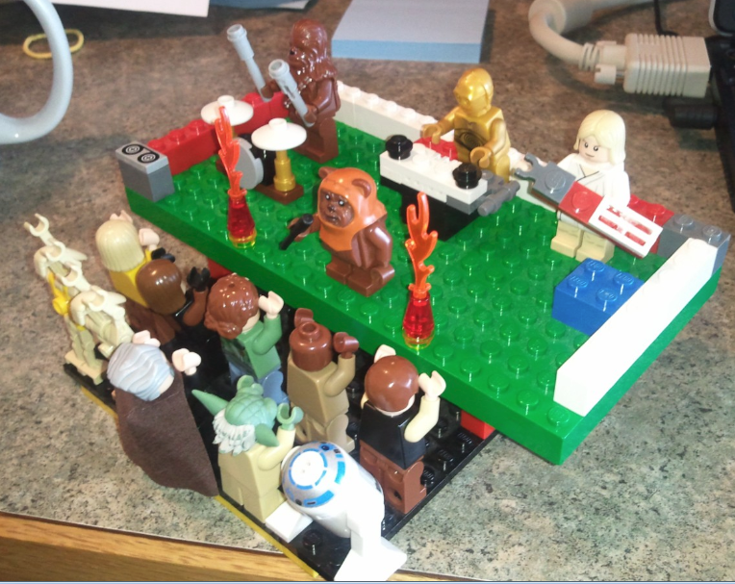
Then you can really ROCK!

Slide 11
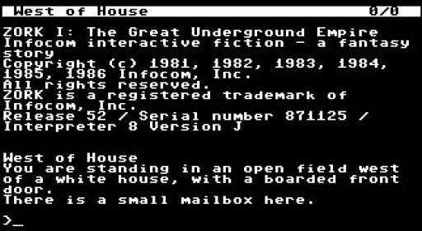
What is a Text Adventure Game?

Slide 12

Getting Started – Visual Studio Community Edition
This presentation will use C# language, but text adventure games can be written in any language

Slide 13
What we need
Variable
If Statement
While loop

Slide 14
What is a Variable?
A variable is a like a suitcase.
You store values in it to keep track of things
You can change it’s value
Variables store different types of things

Slide 15
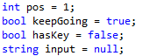
What type of Variables we will use?
Integer (int)
Boolean (bool)
String
A number value
True or False
Letters

Slide 16
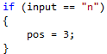
If Statement
The curly brackets define what will happen if the if statement is true.

Slide 17
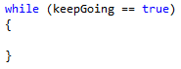
While Loop

Slide 18
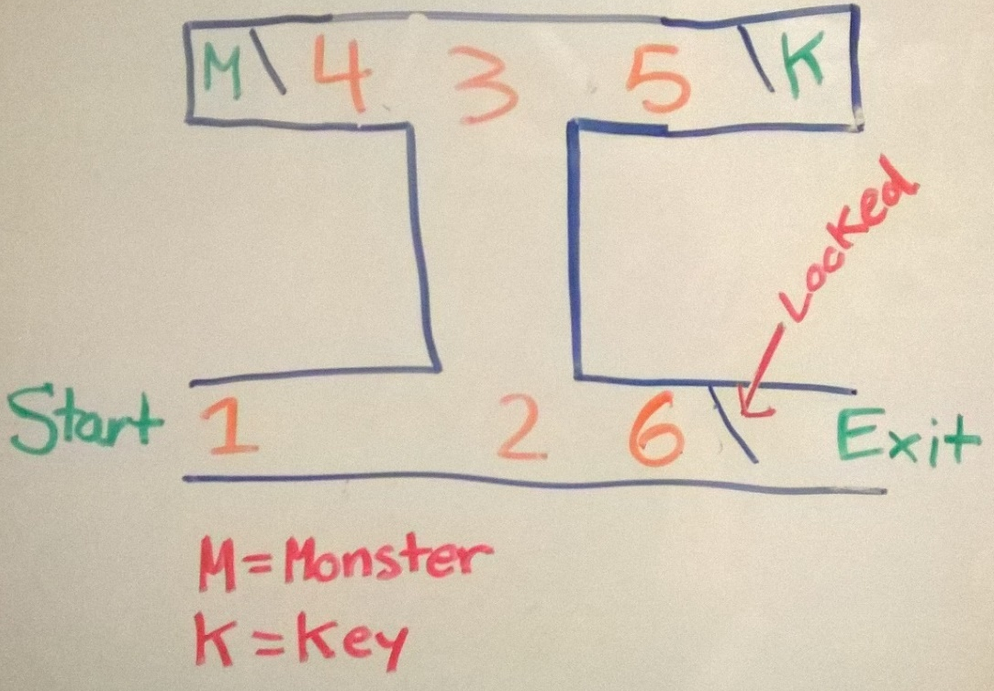
How to Get Started
Make yourself a map.
Number your positions.

Slide 19
How does the Key work?
If you have the Key, you can open the door.

Slide 20
Tip
“=“ is setting the value. “==“ is asking if it is equal
Ex:
pos = 2;
if (pos ==2)
{
[Insert code here];
}

Slide 21
Any Questions?

Slide 22
What are the three things we need for our program?

Slide 23
Let’s play our game!

Slide 24
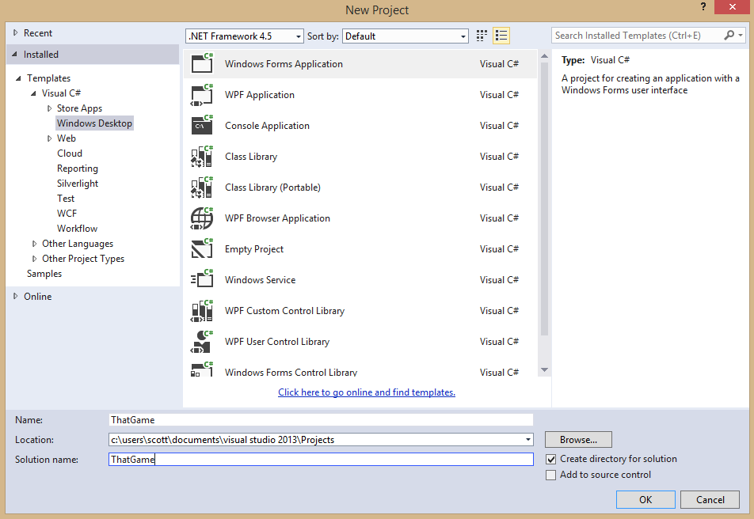
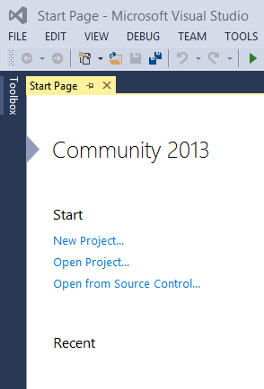
New Project

Slide 25
Review…
What are the three types of variable that we used and what do they mean?
What does an “if statement” do?
What is a “while loop”?

Slide 26
Why text adventure is a great way to learn programming
You only need to learn 3 programming concepts
It is very repetitive, which is great for learning and memorization
You can build games that are very small or extremely large
You don’t have to know how to build graphics, so it is easy
Text adventure is an old but creative and fun type of game

Slide 27
De-bug-ing!
Red, squiggly lines!
No syntax errors
breakpoints

Slide 28
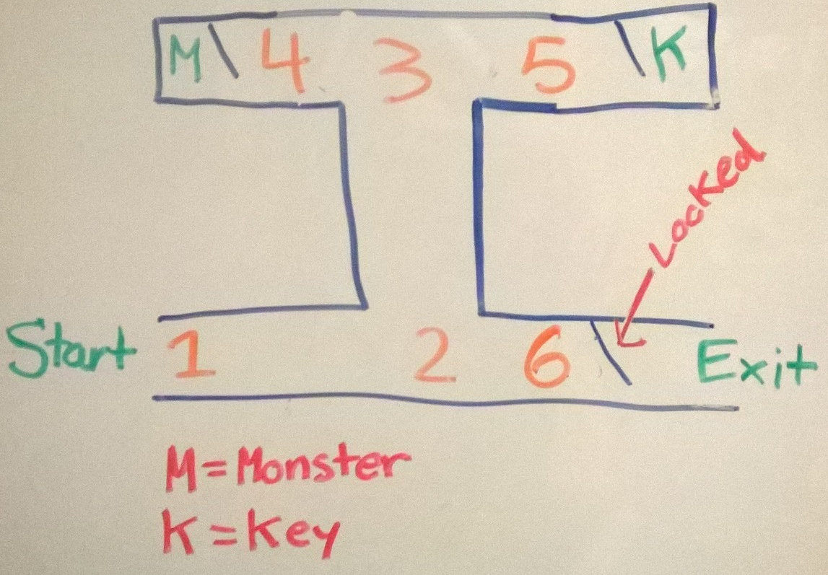
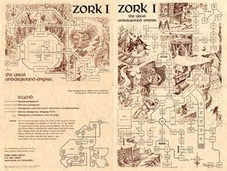
What can we do to expand our game?
And what’s next?

Slide 29
Advice to Parents
Computers can still be fun with out graphics.
Plan your game before you code
Repetition needs to happen for creativity to happen.

